Slide 1
UFCFB6-30-2 Object-oriented Software Development
Unit 2 Modelling Requirements: Use Cases
Benedict R. Gaster
2016-17

Slide 2
From Week 1 --- A taster of the design
Case Study UweFlix.doc
Produce a software design using UML to capture
The requirements
The structure of the system
The dynamic behaviour of the system
Implement it using Java or any other OO language

Slide 3
Outline
Design Problem – Software Requirements
What is a use case?
What is an actor?
Use Case diagram in UML?
How to describe Use Cases?
Use cases – discovery and exploration

Slide 4
Discover and capture requirements
Software Design challenge (1):
how to discover the required behaviour of the design problem? and who’s the software for anyway?
Software Design challenge (2):
how to document the required behaviour so all the stakeholders can understand and agree that this is the design problem we’re all working to solve?

Slide 5
Design Problem – Software Requirements
Elicited from many sources, work with your system’s stakeholders to generate a full set of requirements
Desired Quality Attributes
(Non-functional
Requirements)
Enterprise Objectives
Business Process Model
Integration with current software systems capabilities
Legal, and
enterprise Rules

Slide 6
Requirements engineering
The process of establishing the services that the customer requires from a system and the constraints under which it operates and is developed.
The requirements themselves are the descriptions of the system services and constraints that are generated during the requirements engineering process.

Slide 7
Types of requirement
User requirements
Statements in natural language plus diagrams of the services the system provides and its operational constraints. Written for customers.
System requirements
A structured document setting out detailed descriptions of the system’s functions, services and operational constraints. Defines what should be implemented so may be part of a contract between client and contractor.

Slide 8
Functional and non-functional requirements
Functional requirements
Statements of services the system should provide, how the system should react to particular inputs and how the system should behave in particular situations.
Non-functional requirements
constraints on the services or functions offered by the system such as realibility, timing constraints, constraints on the development process, standards, etc.
Notes:
Domain requirements
Requirements that come from the application domain of the system and that reflect characteristics of that domain.

Slide 9
Functional requirements (skip)
Describe functionality or system services.
Functional user requirements may be high-level statements of what the system should do but functional system requirements should describe the system services in detail.

Slide 10
Non-functional requirements (skip)
These define system properties and constraints e.g. reliability, response time and storage requirements. Constraints are I/O device capability, system representations, etc.
Process requirements may also be specified mandating a particular CASE system, programming language or development method.
Non-functional requirements may be more critical than functional requirements. If these are not met, the system is useless.

Slide 11
Non-functional classifications (skip)
Product requirements
Requirements which specify that the delivered product must behave in a particular way e.g. execution speed, reliability, etc.
Organisational requirements
Requirements which are a consequence of organisational policies and procedures e.g. process standards used, implementation requirements, etc.
External requirements
Requirements which arise from factors which are external to the system and its development process e.g. interoperability requirements, legislative requirements, etc.

Slide 12
Key points
Requirements set out what the system should do and define constraints on its operation and implementation.
Functional requirements set out services the system should provide.
Non-functional requirements constrain the system being developed or the development process.
User requirements are high-level statements of what the system should do. User requirements should be written using natural language, tables and diagrams.

Slide 13
Prioritization of requirements
One prioritization method, called MoSCoW , was developed by Dai Clegg
It separates the Functional Requirements into four different categories:
Must have – Highest level priority.
Should have – Medium level priority.
Could have – Lowest level priority.
Won’t have – for requirements that are determined to not be necessary.
Ref: Clegg, Dai; Barker, Richard (2004-11-09). Case Method Fast-Track: A RAD Approach. Addison-Wesley.ISBN 978-0-201-62432-8.

Slide 14
Use case view (skip)
Notes:
Logical view
Describes the abstract descriptions of a system’s parts. Used to model what a
system is made up of and how the parts interact with each other. The types of
UML diagrams that typically make up this view include class, object, state
machine, and interaction diagrams.
Process view
Describes the processes within your system. It is particularly helpful when visualizing
what must happen within your system. This view typically contains
activity diagrams.
Development view
Describes how your system’s parts are organized into modules and components.
It is very useful to manage layers within your system’s architecture. This view
typically contains package and component diagrams.
Physical view
Describes how the system’s design, as described in the three previous views, is
then brought to life as a set of real-world entities. The diagrams in this view
show how the abstract parts map into the final deployed system. This view typically
contains deployment diagrams.
Use case view
Describes the functionality of the system being modeled from the perspective of
the outside world. This view is needed to describe what the system is supposed
to do. All of the other views rely on the use case view to guide them—that’s why
the model is called 4+1. This view typically contains use case diagrams,
descriptions, and overview diagrams.

Slide 15
What is a use case?
A use case is a structure for documenting the functional requirements for a software system.
Each use case provides a set of scenarios that convey how the system should interact with a human user or another system, to achieve a specific business goal.
Use cases typically avoid technical jargon, preferring instead the language of the end-user or domain expert.
Use cases are often co-authored by requirements engineers and stakeholders.
Use cases are deceptively simple tools for describing the behavior of software or systems.
A use case contains a textual description of the ways in which users are intended to work with the software or system.
Use cases should not describe internal workings of the system, nor should they explain how that system will be implemented. Instead, they show the steps needed to perform a task.

Slide 16
Use case
A use case defines the interactions between external actors and the system under consideration to accomplish a goal.

Slide 17
What is an Actor?
Human being in a Role
E.g. Sales Person
Time-based events
Other external components,
or Systems
External to
(i.e. NOT part of)
the system
E.g. End of Day

Slide 18
What is an actor?
In Use Case modelling with the UML, actors can be anything that interacts directly with the system, examples include:
people using the system in a particular role (or set of roles),
other electronic devices or computer systems,
abstract concepts such as time or dates.
Actors must be :
External to the system being modelled,
Provide direct interaction and exchange information with the system.
Entities that are indirectly connected to the system are not actors because their needs must be communicated to the system by an actor. E.g. Customer talks to customer service agent.

Slide 19
Identifying actor
Ask the following questions:
Who uses the system?
Who starts up / shuts down the system?
Who maintains the system?
What other system(s) use this system?
Who gets information from the system?
Who provides information to the system?
Does anything happen automatically at a preset time?

Slide 20
Identifying actor? (skip)

Slide 21
Use Case diagram in UML?
Unit of interaction between actor and system
In UML it is drawn as an oval with a name that describes the interaction
A communication line connects an actor and a use case to show the actor participating in the use case.
Sum of all use cases represents the scope of design

Slide 22
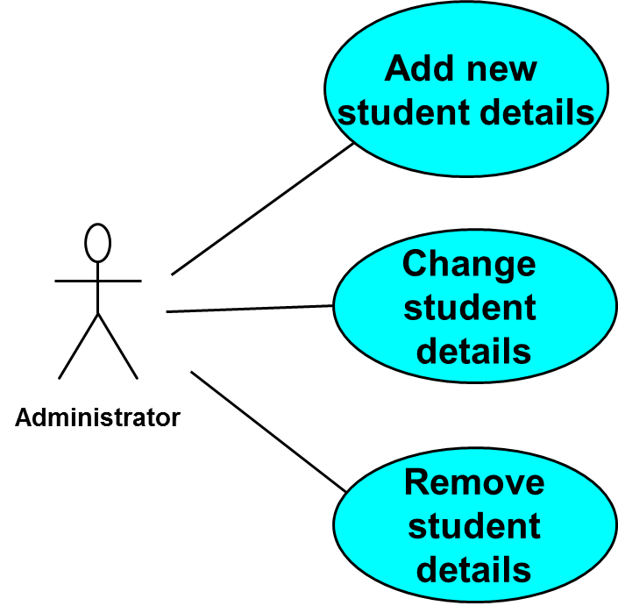
Use Case diagram for a Student record system

Slide 23
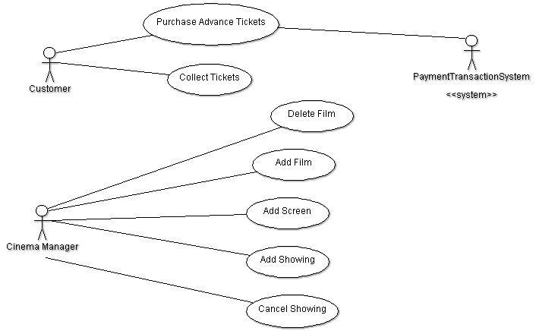
Use case diagram for UweFlix
Do not have orders between the use cases

Slide 24
How to describe Use Cases?
Widget Store System
Amend
Widget Details
Clerk
Use Case: Amend Widget Details
Actor requests to search for a Widget
System displays list of potential Widgets
Actor chooses Widget
System provides Widget Details
Actor amends Widget Details
System updates Widget Details
in natural language;
users perspective;
actors own vocabulary;
users intent
start and end points
clear separation of actor and system
Notes:
In the Select Component Factory tool, the use case description describes the sequence and flow of dialogue between the actor and the system.
The dialogue must be two way and conversational i.e.
Actor requests….
System responds….
Actor requests….
Etc...
Alternative flow …
The use case:
Describes basic and alternate courses in natural language;
Is written from the users perspective;
Use actors own vocabulary;
Clearly define users intent;
Present terminology that is consistent (i.e. Customer or Client).
Clearly define start of end points - end point typically yielding value to the actor.

Slide 25
Use case: basic flow and alternative flow
Instances
of Flows
Description
Alternate
Flows
(extensions)
Basic Flow
(primary scenario)
Notes:
A scenario is an instance of a course or flow through a use case.
A use case is not a single scenario - a specific history of specifics events exchanged among system and actors - but rather a description of a set of potential scenarios. Each scenario must begin with some initial event from an actor to the system.
It is desirable to separate the basic course from alternatives because a use case describes a set of sequences, not just a single sequence, and it would be impossible to to express all the details of an interesting use case in just one sequence.
Typically, there is an expansion factor from use cases to scenarios. A more complex use case may be described by a basic course scenario and a number of alternate course scenarios of interest.

Slide 26
An example: content management system
Create a new blog account use case

Slide 27
Use case description for the “Create a new Blog Account” use case
Main Flow Step Action
The Administrator asks the system to create a new blog account.
The Administrator selects an account type.
The Administrator enters the author’s details.
The System verifies the author’s details using the Author Credentials Database.
The system creates the new blog account is created.
The system emails a summary of the new blog account’s details to the author.
Extensions
4a The Author Credentials Database does not verify the author’s details.
4b The system rejects the author’s new blog account application.

Slide 28
UweFlix – in class exercise
Make Advance Booking use case:
Make advance
booking
customer

Slide 29
AdvanceBooking – Basic/Main flow
MakeAdvanceBooking use case description:
Customer: selects a date
System: displays a list of showings.
Customer: selects a showing
System: displays details of showing
Customer: enters quantity of tickets required, together with the ticket type.
System: checks availability
System: shows total booking cost
Customer :confirms booking
System: validates card details and transacts payment
System: confirms booking

Slide 30
AdvanceBooking – Alternative flow
Extensions:
6a: There are insufficient seats available
.1: System cancels the booking request and asks the customer to make a new booking request
8a: Price is too high
.1: Customer cancel booking
……

Slide 31
What is the Include relationship?
Included
Use Case
Common sequence of interaction
Notes:
During analysis, it may be recognized that certain sequences of narrative text appear repeatedly among a number of use cases I.e. the same narrative text may be common to a number of use cases. It is possible to factor out this commonality into a use case in its own right with the intent of making it useable by other use cases.
Note that the narrative text of the included use case may be used by the including use case at any point in the sequence of its narrative text.
Note also that the included use case never stands alone, but is only instantiated as part of another use case that includes it. Put another way, included use cases yield no benefit to the actor in themselves, and so are not triggered by an event supplied by an actor. Rather, they are “triggered” by the including use case.

Slide 32
Include on UML Use case Diagrams
Find Widget
Details
<<include>>
<<include>>
<<include>>
Quote
Service
Browse
Catalogue
Book Job
Clerk
Notes:
Within UML use case diagrams, the include relationship is graphically rendered as dependency (a connecting line with an open arrow head), stereotyped as <<include>>. The arrow head points to the use case being included.

Slide 33
Example of <<include>>
Both are correct

Slide 34
What is the Extend relationship?
Significant
Alternate
Course
Description
Extending
Use Case
Notes:
A powerful concept that is used to structure and relate use case descriptions is the extension association. Extension specifies how a significant alternate course may be inserted as a use case in its own right, and thus extend another use case description. Extensions to use cases can be described in a simple way and, in particular, changes and additions to functionality are more easily made.
The use case that is extended must be a complete use case in itself, and typically encapsulates a significant alternate course within a use case.
Being derived from an alternate course, the extends use case is only executed when its particular scenario is followed.
Some examples of when to use extends:
To model optional parts of use cases (e.g. error handling);
To model complex and alternate courses which seldom occur;
To model separate sub-courses which are executed only in certain cases.

Slide 35
<<Extend>> on UML Use Case Diagrams
Book Rush
Job
<<Extend>>
Book Job
Clerk
Notes:
Within UML use case diagrams, the extend relationship is graphically rendered as dependency (a connecting line with an open arrow head), stereotyped as <<extend>>. The arrow head points to the use case from which the extension is being made. Note that when reading UML use case diagrams, extend relationships read the other way around to include relationship.

Slide 37
Organising the use case model
“include” and “extend” relationships can be useful to create a balanced and understandable set of use cases
However, should only be applied when appropriate to the simplification, understandability and organisation of the use case model.
Notes:
Practically, when organising the use case model, include, extend and generalisation relationships can be useful to create a balanced and understandable set of use cases at a similar level of granularity. However, care should be exercised as these relationships should only be applied when appropriate to the simplification, understandability and organisation of the use case model. Not that excessive use of include, extend and generalisation relationships can destroy the understandability and consistent level of granularity of the use case model.

Slide 38
Use cases – discovery and exploration
Identify actors
Agree with stakeholders
Identify use cases (goals) for each actor
Agree with stakeholders
Explore scenarios, extensions
Agree with stakeholders
Prepare UML diagram and use case descriptions for communication
Agree with stakeholders
ONLY THEN apply <<include>>, <<extend>>, etc.

Slide 39
Use cases -reflection
Easy to explore system’s requirements with clients, identifying missing functionalities, and discard unnecessary requirements
Use case can be viewed as a contract with all stake holders because it can be explored and agreed jointly.
Use cases also help construct tests for your system. Use cases provide an excellent starting point for building your test cases.
They do not specify the system’s non functional requirements such as performance targets.
Only suitable for certain type of system.

Slide 40
Summary
Identify candidate system actors
(1) humans, (2) external event, (3) other systems
Identify candidate use cases
What goals does each Actor wish to achieve?
Refine and scope units of interaction (use cases)
start point (look for actor and initial event)
end point (look for beneficial result – the goal - for actor)
Notes:
Where business process modelling has been performed, a good place to start on use case identification is to examine the Elementary Business Processes as revealed in Process Thread diagrams. Next, identify candidate actors for the system-to-be and their likely events or requests that would trigger a use case. This may then be contrasted with Business Actors.
When scoping the start and finish of the use case, it is useful to adopt the view point of the actor in deriving a result of value from useful work conducted by the use case. The end point of the use case often yields the post-condition of the use case which reflects the system’s side of the bargain in the use case ‘contract’.
Remember that the process of identifying use cases scopes the extent of the automated system-to-be, and so balanced judgements should be arrived at as to which Business Processes are candidates for automation.

Slide 41
Summary
Use case scenarios and extensions
UML Use case relationships
<<include>>, <<extend>>

Slide 42
References
Learning UML2.0
UML distilled

Slide 43
Any questions?

